Slide 1
A World Without Black People
Philip Meagwali

Slide 2
Sarah Boone
Ironing Board
In 1892 Sarah Boone invented an improvement to the ironing board, not the board itself. Her brainchild was a curved narrow board that allowed for the sleeves of ladies’ garments to be stretched over it.

Slide 3
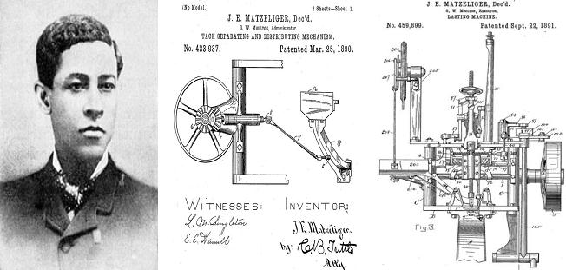
Jan E. Matzeliger
Shoe Lasting (making) Machine
In 1883 Jan Ernst Matzeliger come up with an original innovation that changed how a particular item was made: he devised a machine that would sew the sole to the upper of a shoe in about a minute. His “shoe lasting” machine changed the process of how shoes were made by mechanizing a part of their manufacture that previously had to be done by hand and thereby cut the cost of making shoes by half.

Slide 4
Walter Sammons Heated Comb
Combs have been around about as long as humans have; archaeologists are hard-pressed to find a burial mound or grave of any age that doesn’t contain them. Walter Sammons invented a heated comb, a device to help with the straightening of hair.

Slide 5
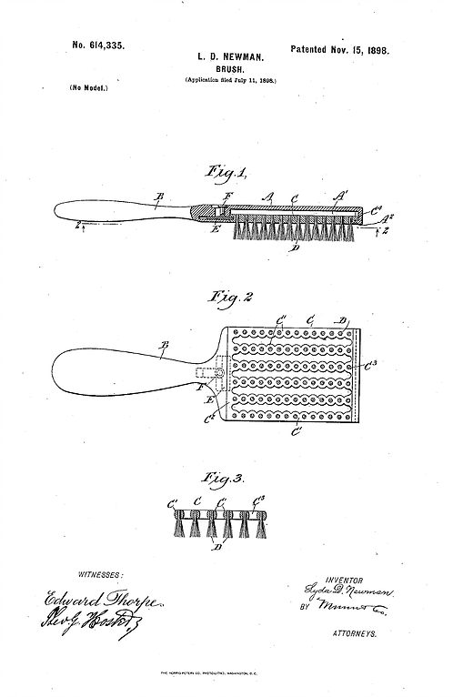
Lydia O. Newman
The first hairbrush with synthetic bristles was invented by Lydia O. Newman in 1898.

Slide 6
Madam C. Walker
Hair Care Products

Slide 7
Lloyd P. Ray
Long-Handled Dust Pan
In 1897 Lloyd P. Ray invented not the dust pan, but the long-handled dust pan, a device that allowed the sweeper to not have to bend over to hold the pan to the floor so as to collect the sweepings.

Slide 8
Thomas W. Stewart
Self-Wringing Mop
In 1893 Thomas W. Stewart (not Steward) crafted a self-wringing form of mop, but did not invent the mop itself.

Slide 9
George T. Sampson
Clothes Dryer
George T. Sampson (not Samon) was granted the first U.S. patent for a clothes dryer, in 1892.

Slide 10
John Love
Pencil Sharpener
In 1897 John Lee Love invented a simple, portable pencil sharpener he dubbed the “Love Sharpener.” This was not the first implement of this nature: the manual pencil sharpener was invented in 1847 by Therry des Estwaux and was at least conceived of in 1828, the year a Frenchman named Bernard Lassimone applied for a patent on one.

Slide 11
William B. Purvis
Fountain Pen
William B. Purvis patented a number of improvements to the fountain pen in 1890. Fountain pens themselves had been around since 1809.

Slide 12
Lee Burridge
Typewriting Machine
Lee Burridge fashioned a number of typewriter improvements, but he did not invent the typewriter — the first patent for such a machine was issued in 1868 to Christopher Latham Sholes.

Slide 13
W. A. Lovette
Improvements to the Printing Press
The first printing press is attributed to Johannes Gutenburg in 1450

Slide 14
John Burr
Lawn Mower
In 1899 John Albert Burr devised an improved rotary blade lawn mower, the patent for a “machine for mowing lawns, etc.” dates to 1830, to a British engineer named Edwin Beard Budding.

Slide 15
Richard Spikes
Automatic Gear Shift
Richard Spikes crafted an improved automatic gear shift in 1932, but he did not invent this bit of technology. You also have Mr. Spikes to thank for your car’s turn signals. He invented automatic directional lights, which were first installed on a Pierce Arrow automobile in 1913.

Slide 16
Joseph Gammel
Supercharger

Slide 17
Garrett A. Morgan
Traffic Signal
Garrett A. Morgan invented the automated traffic signal in 1923, but the first known traffic signal was designed in 1868 by J.P. Knight in England. Morgan sold the rights to his patent to General Electric for $40,000, which was an astonishing sum back in those days.

Slide 18
John Standard Refrigerator
In 1891 John Standard came up with an improvement to the refrigerator, not the refrigerator itself, which was first patented in Scotland in 1748 by William Cullen.

Slide 19
Alice Parker
Heating Furnace
Furnaces have been around for thousands of years, dating back at least as far as to the Romans. While Alice Parker did in 1919 secure a patent on a furnace, by 1888, more than 4,000 patents on heating stoves and furnaces had been granted in the U.S.

Slide 20
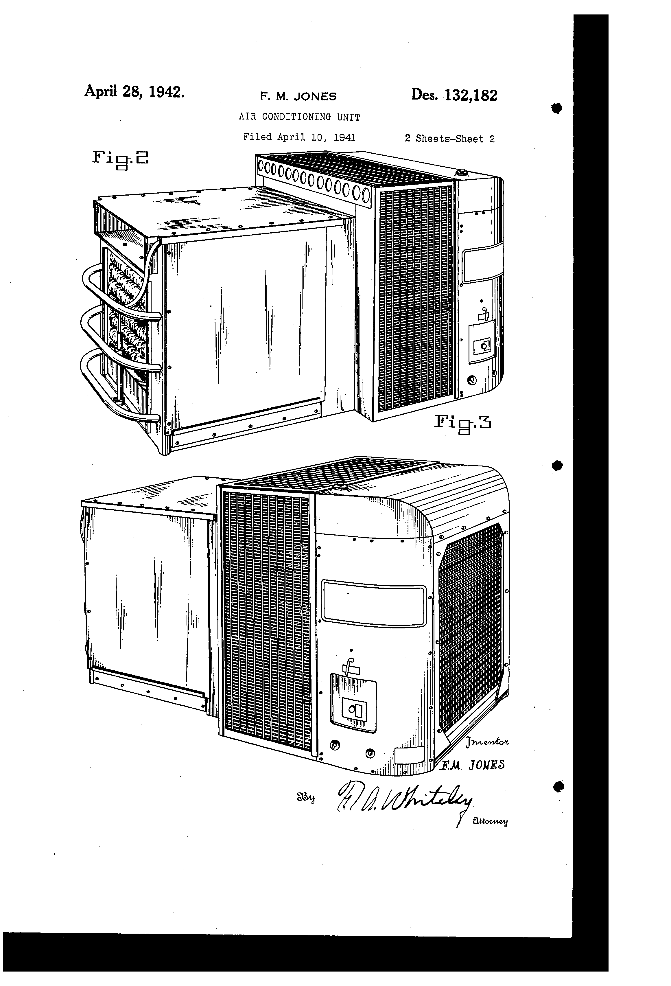
Frederick Jones
Portable Air Conditioner & Refrigerated Truck
Frederick McKinley Jones did not invent the air conditioner (that honor properly belongs to Willis Carrier, who patented it in 1902), but he did design the portable air conditioning unit used at military field hospitals in World War II. It allowed the military to store perishable life-saving medicines and blood serum close to the battlefield, even in the Pacific theater of operations where temperatures and humidity would otherwise have made short work of such products, and thus of the men dependent on receiving them. In 1935 Frederick McKinley Jones (of the portable air conditioning unit) invented the first refrigerated truck. He kept tinkering at his innovation, eventually developing a highly successful automatic refrigeration system for long-haul carriers. Prior to Jones’ invention, many people were primarily limited to eating foods grown locally, because perishable goods could not be efficiently transported over longer distances.

Slide 21
Elbert R. Robinson Electric Trolley

Slide 22
Alexander Miles
Elevator
He devised certain improvements in elevator technology, and even those improvements had nothing to do with moving the cars up and down, which at least would have been a bit more in resonance with the “invented the elevator” claim. His contributions to elevator technology had to do with their doors.

Slide 23
Philip Downing
Letter Box
Philip Downing invented a particular kind of letter drop mailbox in 1891, but such boxes had been around at least since 1858.

Slide 24
William Berry
Postmark and Canceling Machine
William Barry invented a postmarking and canceling machine in 1897. The first of that sort of contraption was created in England in 1857 by Pearson Hill.

Slide 25
Lewis Howard Latimer
Electric Light Filament
In 1882 Lewis Howard Latimer invented a method of making carbon filaments for the Maxim electric incandescent lamp.
He did not invent the lightbulb itself.

Slide 26
Dr. Charles Drew
Preservation of Human Blood and First Blood Bank

Slide 27
Dr. Daniel Hale Williams
First Open Heart Surgery

